Slide 1
Planner App
(concept)

Slide 2
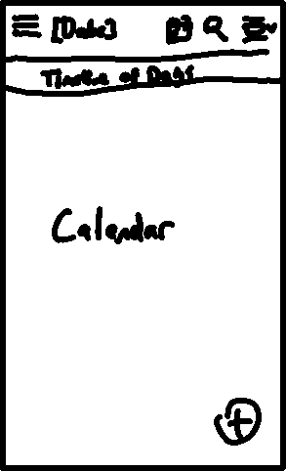
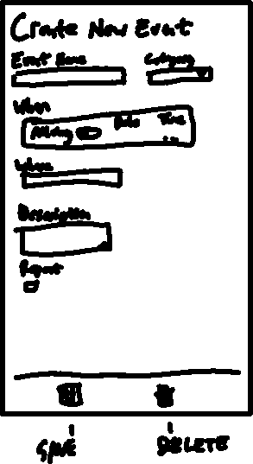
Planner App (concept)
Page 1
Page 2

Slide 3

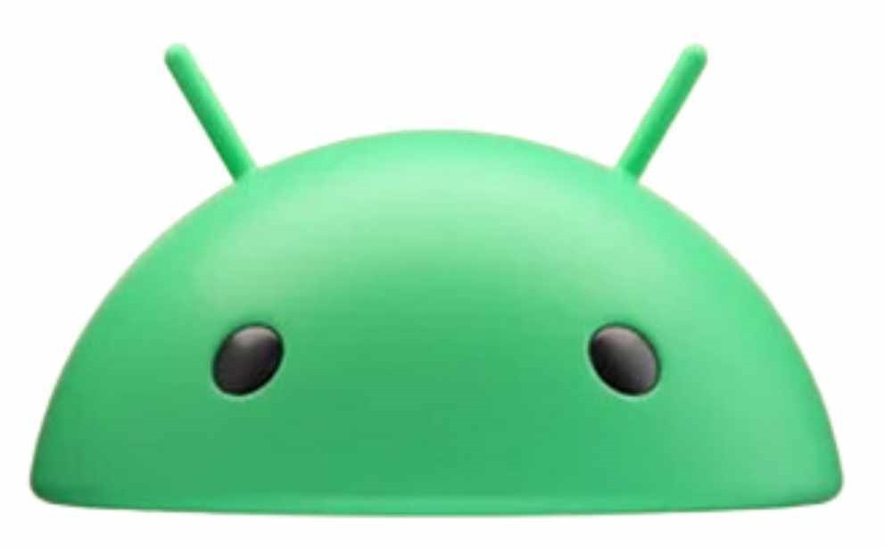

Planner App (development)
Platform: Android
Language: Kotlin + Jetpack Compose

Slide 4
Planner App (hopes and dreams)
6-person team
3 for each page
Completion of basic event scheduling

Slide 5
Planner App (desired minimum requirements)
Schedule creation on current day (planner future & history is a hope)
Functional pages
Polish

